Slide 1
Preliminary Design Review: Traybot
James Ravenhill- 10699148, Ben Evans - 10362555

Slide 2
Scope
Introduction
Project goals
Requirements in order to reach our goals
Concept so far
Simulation so far
Gantt chart for project plan
Hold all questions until the end
Disconnection

Slide 3
Motivation
Hospital staff must often care for many patients simultaneously.
Delivering food or medicines to a patient suffering from an infectious disease requires time-consuming sanitization procedures.
Risk is not completely eliminated
Hand contamination with MRSA occurs as often when healthcare staff touch contaminated surfaces as with direct contact with an infected patient [11]
A robot could be used to complete these tasks, freeing time for nurses to conduct more important tasks.

Slide 4
Introduction
The main idea for our project is to create a logistics health care robot capable of being able to distribute material around a hospital with the use of trays.
Similar concepts have been implemented before…

Slide 5
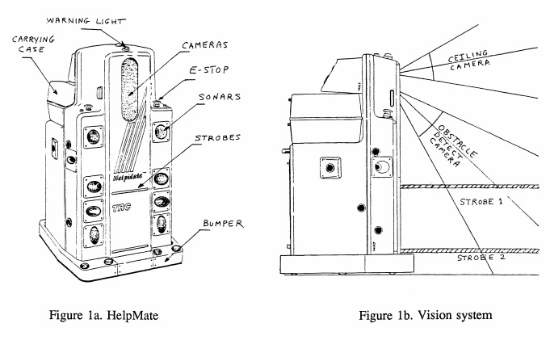
Helpmate autonomous mobile robot (1991) [1]
An early implementation (~1991)
Capable of transporting meal trays
Locates itself using ceiling camera- Does not require modification of the environment
Triple redundancy object avoidance- Bumper, Sonar, Structured light

Slide 6
Hospital mobile platform for logistics (2015)[2]
Key points:
A self aligning charging dock allows continued operation
Sensitive material can be locked during transit
Omniwheels were avoided due to noise and vibration concerns – This can be minimized, but this is still an area of research[3]
Regenerative braking identified as method to extend duty time
System requires manual loading/unloading –
This gives the robot the potential to spread pathogens
Bedbound patients may not be able to retrieve materials
Empty containers cannot be retrieved whilst the patient is asleep

Slide 7
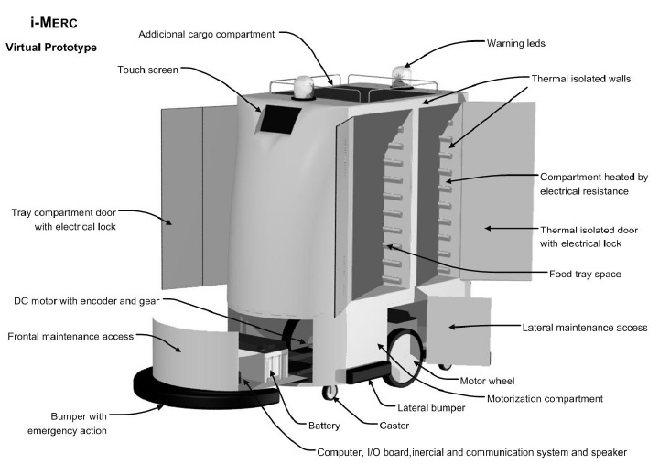
(13) i-Merc: A Mobile Robot to Deliver Meals inside Health Services (prototype) (2006)[4]
Key points:
Identifies that “quality of the food strongly influences the patients’ recovery.”
Keeps interior heated above 60 deg/c to prevent bacteriological growth
This temperature reduces the viral infectivity of various coronaviruses significantly over 1-30 minutes, depending on the strain. [5]

Slide 8
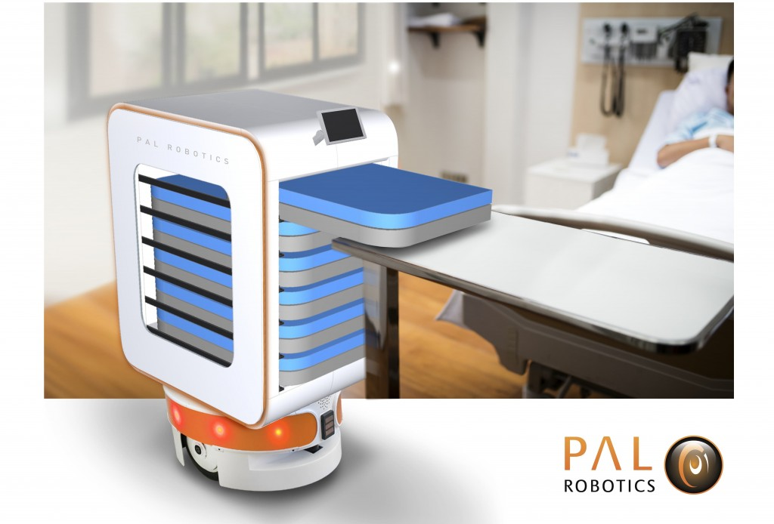
TIAGo: the modular robot that adapts to different research needs [6]
https://blog.pal-robotics.com/covid-19-and-our-robots-ready-to-help-fight-coronavirus-in-hospitals/
Modular base (PMB-2) uses a differential drive
Laserscanner, ultrasound used for environment sensing
Upper body has 35cm adjustable stroke
To the best of our knowledge the bedside tray delivery/collection concept as rendered in the 2nd figure is not widely available.

Slide 9
Project goals
Create a mechanism for the robot to move vertically
Create a tray mechanism which can retrieve as well as dispense trays
Create a wheelbase which can cope with a smooth floor surface, which will allow the robot to be as agile as possible
Create a simple air filtration system
Keep It Simple Stupid (KISS)

Slide 10
Requirements in order to reach our goal
Scissor lift --> linear actuators (rack and pinion)
It should not be possible that at full lift extension, with the arm extended, that the robot overbalances.
The maximum extension of the lift should be limited.
Only one arm may extend at any given time in order to the movement of the centre of mass.
The robot will abort picking a tray if it is overloaded
As much weight as possible should be located in the base of the robot in order to maintain a low centre of mass

Slide 11
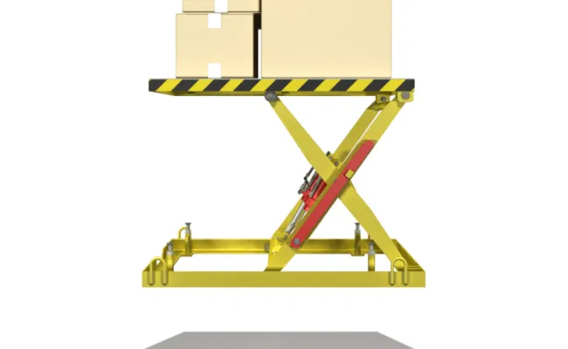
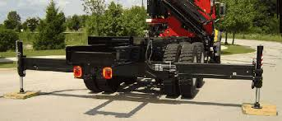
Scissor lift Advantages and disadvantages
Positives
Compact design
Larger reach compared to linear actuators
Negatives
Weight distribution causing un-stability problem

Slide 12
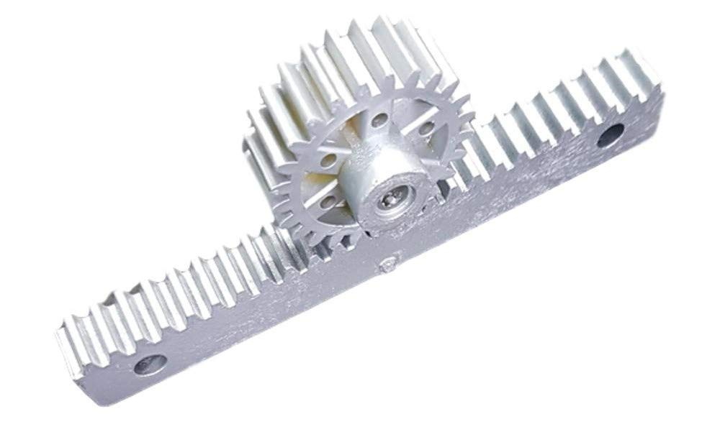
Rack and pinion
Benefits:
Addresses weight distribution problem
Limited reach- addresses the stability issue
Disadvantages:
Requires high torque to drive

Slide 13
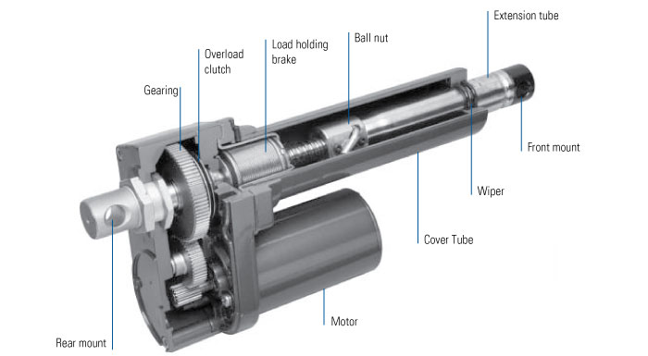
Ballscrew
Benefits:
Addresses weight distribution problem
Limited reach- addresses the stability issue
More precise and efficient than leadscrews
Requires less torque than rack and pinion

Slide 14
2. Square tray --> circular tray Belt drive / rack and pinion
The robot is not required to handle varying individual objects to accomplish its task as they are contained in a tray. Therefore the trays design can be optimized to allow straightforward picking, placing and stowage.
Use of a circular shape avoids tray yaw alignment problems when collecting
A very loose fit, ~1cm, of the tray in the jaw accommodates any other angular misalignment. These are assumed to be minimal for any reasonably level surface.
A curved outer lip allows a simple actuated pin to lock the tray in place when inside the jaws.
The end of the pin should be rubberized to prevent trays rattling during transport
A bright, saturated colour is used to aid in the trays detection and the robots subsequent visual servoing.
Duplicate arms with jaws are used, one for each tray slot. This incurs redundancy of the two motors needed for each arm (one for extension, the other to actuate the pin). However, it allows each arm to fully secure its tray inside the robot during transport. Additionally, this aids in keeping a smaller footprint for the robot as no space is required to accommodate a travelling arm mechanism.

Slide 15
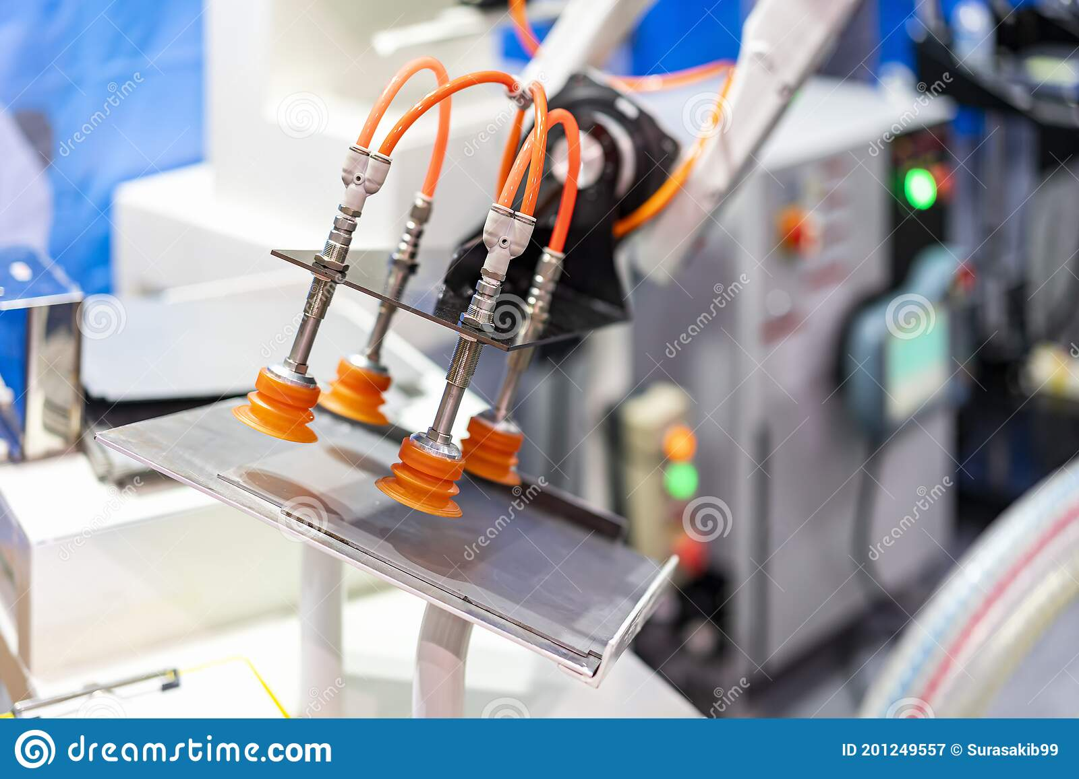
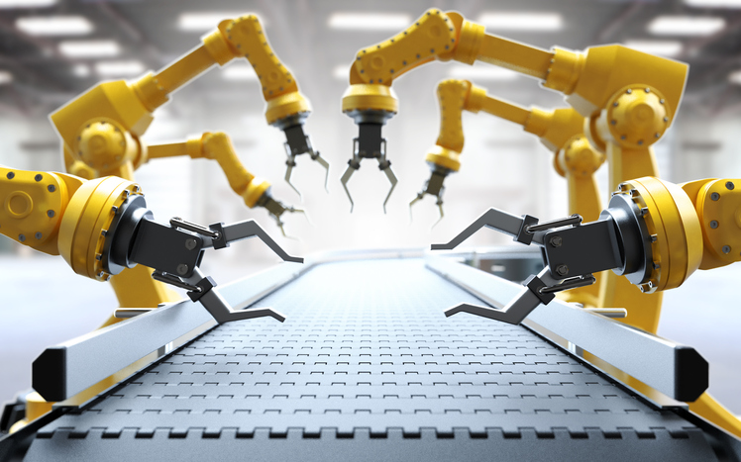
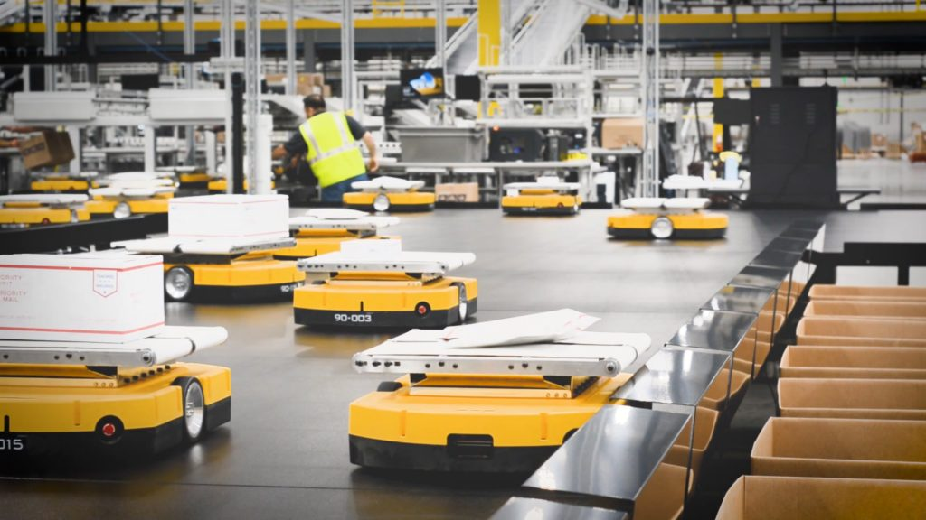
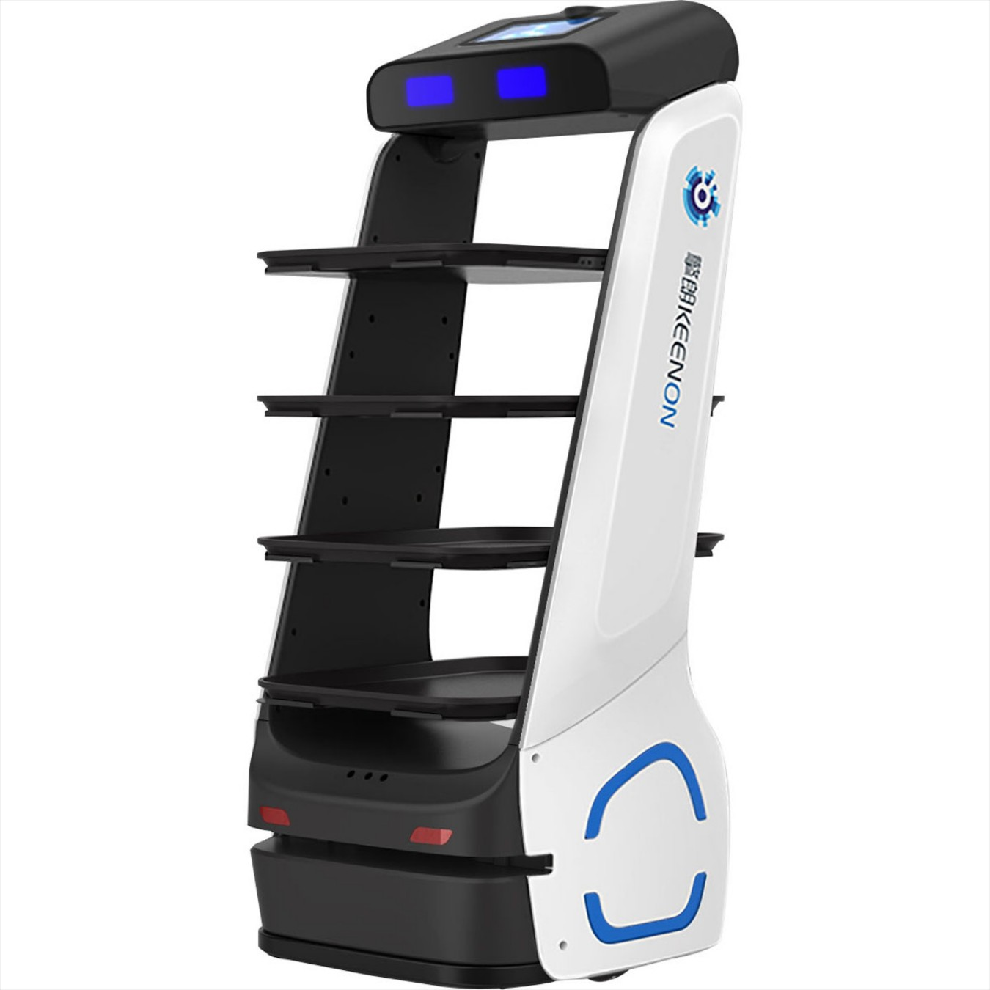
Pick and Place

Slide 16
3. Mobile Base Requirements
Zero radius turning, is required as the mobile base is used to orientate the arm
Platform must provide sufficient stability, as centre of gravity can be raised
High braking force should be possible
A long lifespan
Low noise
Able to accommodate small floor irregularities, such as carpet ridges or door thresholds
There are several candidates…

Slide 17
Omniwheels and Mecanum wheels
Advantages
Holonomic- Any vector of (x, z, w) may be used without prior adjustment
Requires only single actuator per wheel
Disadvantages
Discontinuous wheel contact [7], can cause noise, may impact durability
Does not receive natural suspension capability provided by inflated tyres
Smaller point contact reduces grip
Vulnerable to small ground irregularities
Maximum torque from all motors cannot be utilized simultaneously for forward motion, braking
Experimental Analysis of Mecanum wheel and Omni wheel [8]

Slide 18
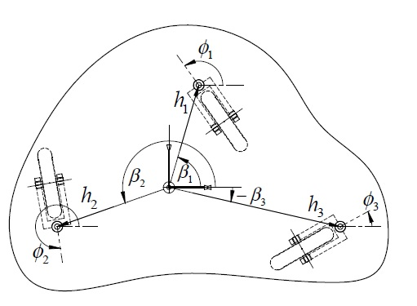
Powered caster vehicle (PCV)
Advantages
Holonomic- Any vector of (x, z, w) may be used, but prior adjustment is required
Allows use of conventional wheels, tyres
Maximum torque from all motors can be utilized simultaneously for forward motion, braking
Disadvantages
Additional steering actuation required for each driven wheel
Steering is required before generated motion can be produced
Steering all wheels at once to specify new vector can cause sudden disturbances [9]
[9] Development and Control of a Holonomic Mobile Robot
for Mobile Manipulation Tasks

Slide 19
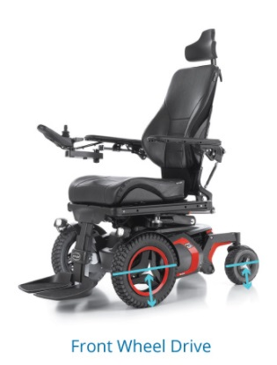
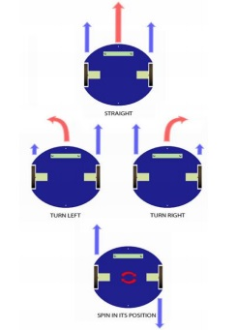
Differential drive with castors
Advantages
Allows use of conventional wheels, tyres
Capable of zero radius turns
Only one motor required per wheel
Maximum torque from all motors can be utilized simultaneously in forward motion and braking
Disadvantages
Unable to move laterally (non-holonomic)
[10] Visually guided mobile robot
https://www.innovacareconcepts.com/en/blog/news/power-wheelchair-types/

Slide 20
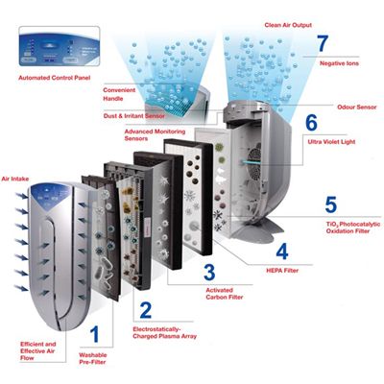
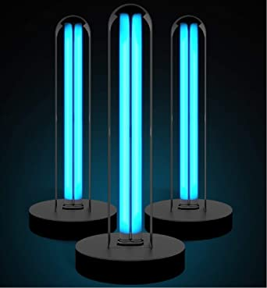
4. Air filtration system
Needs to have a low profile (not interrupt the main task of the robot)
Filters need to be easy to change
UVC light must be confined to reduce contact with humans

Slide 21
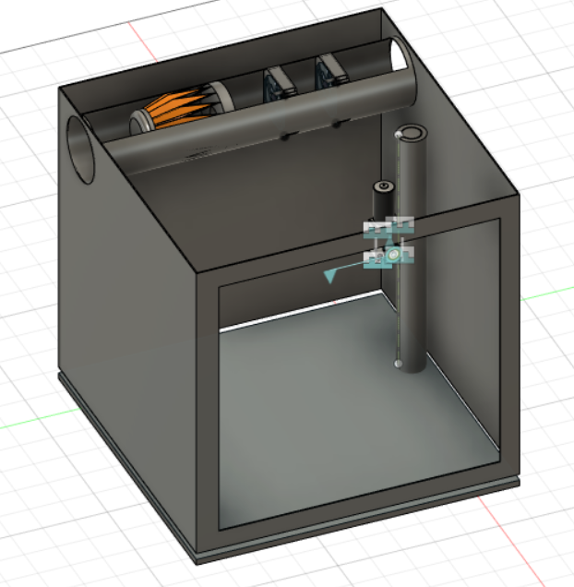
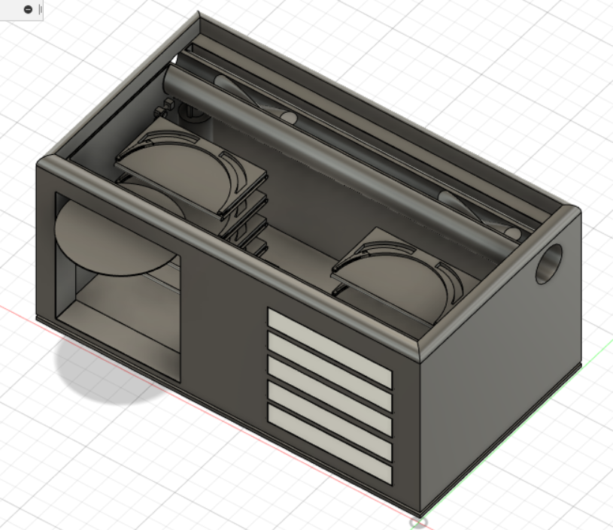
Concept so far

Slide 22
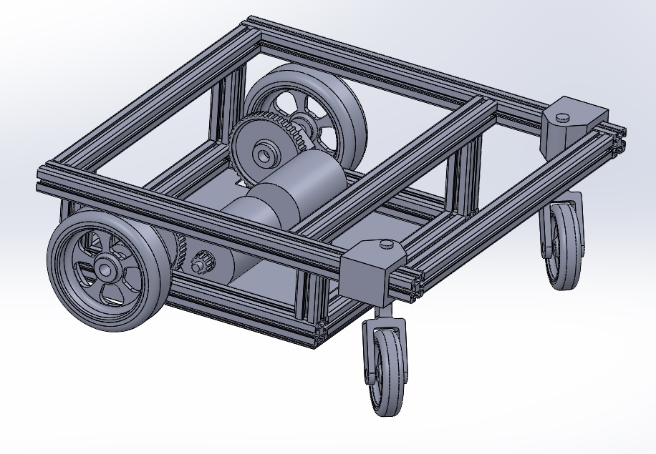
Base measures 0.5x0.5x0.185 metres
High torque DC motors avoid the need for a gearbox
Belt reduction used for quiet running
Driven wheels at front aid maneuverability, and provides more grip when braking

Slide 23
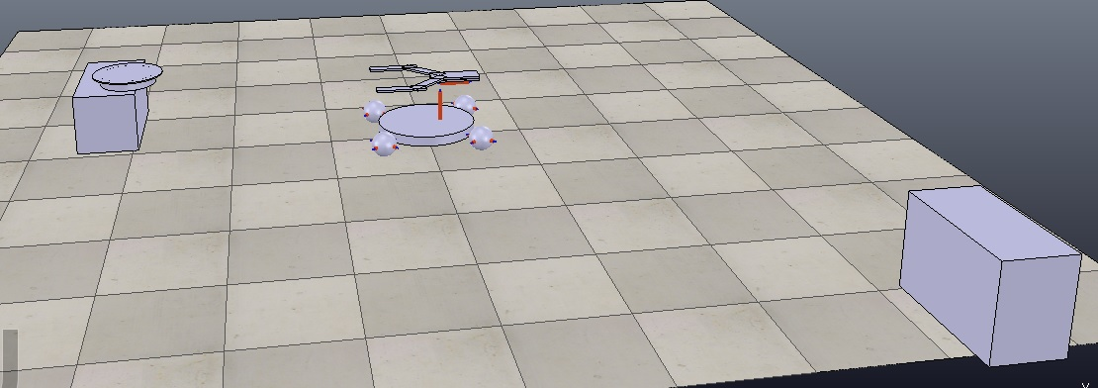
Simulation so far

Slide 24
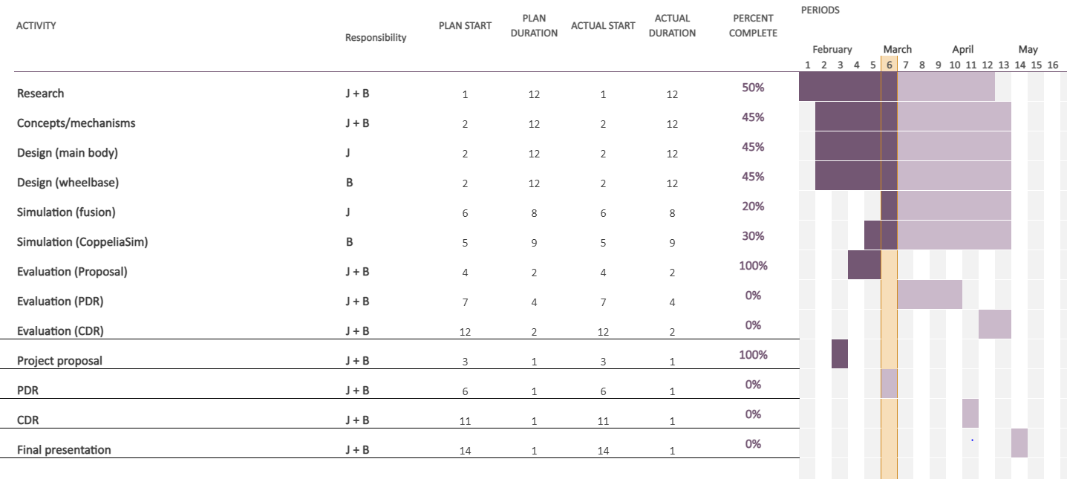
Project plan

Slide 25
Risks and possible mitigations
Robot collision:
Speed limited to walking pace
Triple redundant obstacle sensing (bumper, ultrasound, RGBD)
Internal contamination with pathogens:
Internal space kept above 60c for food storage or suitable temperature for specific medication.
Internal space heated above 75c when empty and charging
Lower slots utilized first, so that clean trays are always above any potentially infected trays

Slide 26
References/added points
[1] S. J. King and C. F. Weiman, "Helpmate autonomous mobile robot navigation system," in Mobile Robots V, 1991, vol. 1388: International Society for Optics and Photonics, pp. 190-198.
[2] C. A. A. Calderon, E. R. Mohan, and B. S. Ng, "Development of a hospital mobile platform for logistics tasks," Digital Communications and Networks, vol. 1, no. 2, pp. 102-111, 2015.
[3] J.-J. Bae and N. Kang, "Design optimization of a mecanum wheel to reduce vertical vibrations by the consideration of equivalent stiffness," Shock and Vibration, vol. 2016, 2016.
[4] F. Carreira, T. Canas, A. Silva, and C. Cardeira, "I-Merc: A mobile robot to deliver meals inside health services," in 2006 IEEE Conference on Robotics, Automation and Mechatronics, 2006: IEEE, pp. 1-8.
[5] M. Klompas, "Coronavirus disease 2019 (COVID-19): protecting hospitals from the invisible," ed: American College of Physicians, 2020.
[6] J. Pages, L. Marchionni, and F. Ferro, "Tiago: the modular robot that adapts to different research needs," in International workshop on robot modularity, IROS, 2016.
[7] F. Adăscăliţei and I. Doroftei, "Practical applications for mobile robots based on mecanum wheels-a systematic survey," The Romanian Review Precision Mechanics, Optics and Mechatronics, vol. 40, pp. 21-29, 2011.
[8] S. Soni, T. Mistry, and J. Hanath, "Experimental Analysis of Mecanum wheel and Omni wheel," International Journal of Innovative Science, Engineering & Technology, vol. 1, no. 3, pp. 292-295, 2014.
[9] R. Holmberg and O. Khatib, "Development and control of a holonomic mobile robot for mobile manipulation tasks," The International Journal of Robotics Research, vol. 19, no. 11, pp. 1066-1074, 2000.
[10] K. A. S. ALJabri and M. S. N. Al-Din, "Visually Guided Mobile Robot." [11] D. J. Weber, D. Anderson, and W. A. Rutala, "The role of the surface environment in healthcare-associated infections," Current opinion in infectious diseases, vol. 26, no. 4, pp. 338-344, 2013.

Slide 27
Thanks for listening!!
Questions??

